Slide 1
Chapter 5 Functions

Slide 2
Opening Problem
Find the sum of integers from 1 to 10, from 20 to 37, and from 35 to 49, respectively.

Slide 3
Problem
sum = 0
for i in range(1, 11):
sum += i
print("Sum from 1 to 10 is", sum)
sum = 0
for i in range(20, 38):
sum += i
print("Sum from 20 to 37 is", sum)
sum = 0
for i in range(35, 50):
sum += i
print("Sum from 35 to 49 is", sum)

Slide 4
Problem
sum = 0
for i in range(1, 11):
sum += i
print("Sum from 1 to 10 is", sum)
sum = 0
for i in range(20, 38):
sum += i
print("Sum from 20 to 37 is", sum)
sum = 0
for i in range(35, 50):
sum += i
print("Sum from 35 to 49 is", sum)

Slide 5
Solution
def sum(i1, i2):
result = 0
for i in range(i1, i2 + 1):
result += i
return result
def main():
print("Sum from 1 to 10 is", sum(1, 10))
print("Sum from 20 to 37 is", sum(20, 37))
print("Sum from 35 to 49 is", sum(35, 49))
main() # Call the main function

Slide 6
Objectives
To define functions.
To invoke value-returning functions.
To invoke functions that does not return a value.
To pass arguments by values.
To pass arguments by values.
To develop reusable code that is modular, easy to read, easy to debug, and easy to maintain.
To create modules for reusing functions.
To determine the scope of variables.
To define functions with default arguments.
To return multiple values from a function.
To simplify drawing programs using functions.

Slide 7
Defining Functions
A function is a collection of statements that are grouped together to perform an operation.

Slide 8
Function Header
A function contains a header and body. The header begins with the def keyword, followed by function’s name and parameters, followed by a colon.

Slide 9
Formal Parameters
The variables defined in the function header are known as formal parameters.

Slide 10
Actual Parameters
When a function is invoked, you pass a value to the parameter. This value is referred to as actual parameter or argument.

Slide 11
Return Value
A function may return a value using the return keyword.

Slide 12
Calling Functions
Testing the max function
This program demonstrates calling a function max to return the largest of the int values
# Return the max between two numbers
def max(num1, num2):
if num1 > num2:
result = num1
else:
result = num2
return result # Return result
def main():
i = 5
j = 2
k = max(i, j) # Call the max function
print("The maximum between", i, "and", j, "is", k)
main() # Call the main function
The maximum between 5 and 2 is 5
Test Max

Slide 13
Calling Functions, cont.

Slide 14
Trace Function Invocation
Invoke the main function

Slide 15
Trace Function Invocation
i is now 5

Slide 16
Trace Function Invocation
j is now 2

Slide 17
Trace Function Invocation
invoke max(i, j)

Slide 18
Trace Function Invocation
invoke max(i, j)
Pass the value of i to num1
Pass the value of j to num2

Slide 19
Trace Function Invocation
(num1 > num2) is true since num1 is 5 and num2 is 2

Slide 20
Trace Function Invocation
result is now 5

Slide 21
Trace Function Invocation
return result, which is 5

Slide 22
Trace Function Invocation
return max(i, j) and assign the return value to k

Slide 23
Trace Function Invocation
Execute the print statement

Slide 24
Trace Function Invocation
Return to the caller

Slide 25
Functions With/Without Return Values
This type of function does not return a value. The function performs some actions.
# Print grade for the score
def printGrade(score):
if score >= 90.0:
print('A')
elif score >= 80.0:
print('B')
elif score >= 70.0:
print('C')
elif score >= 60.0:
print('D')
else:
print('F')
def main():
score = float(input("Enter a score: "))
print("The grade is ", end = "")
printGrade(score)
main() # Call the main function
# Return the grade for the score
def getGrade(score):
if score >= 90.0:
return 'A'
elif score >= 80.0:
return 'B'
elif score >= 70.0:
return 'C'
elif score >= 60.0:
return 'D'
else:
return 'F'
def main():
score = float(input("Enter a score: "))
print("The grade is", getGrade(score))
main() # Call the main function
Enter a score: 89
The grade is B
Enter a score: 65
The grade is D
Enter a score: 93
The grade is A
Enter a score: 59
The grade is F
Enter a score: 89
The grade is B
Enter a score: 65
The grade is D
Enter a score: 93
The grade is A
Enter a score: 59
The grade is F
Print Grade Function
Return Grade Function

Slide 26
Passing Arguments by Positions
def nPrintln(message, n):
for i in range(0, n):
print(message)
Suppose you invoke the function using
nPrintln(“Welcome to Python”, 5)
What is the output?
Suppose you invoke the function using
nPrintln(“Computer Science”, 15)
What is the output?
What is wrong
nPrintln(4, “Computer Science”)
TypeError: 'str' object cannot be interpreted as an integer

Slide 27
Pass by Value
When you invoke a function with a parameter, the value of an argument is passed to a parameter.
If the argument is a number or a string, the argument is not affected, regardless of the changes made to the parameter inside the function.

Slide 28
Pass by Value
def main():
x = 1
print("Before the call, x is", x)
increment(x)
print("After the call, x is", x)
def increment(n):
n += 1
print("n inside function increment is", n)
main() # Call the main function
Before the call, x is 1
n inside function increment is 2
After the call, x is 1
Increment

Slide 29
Modularizing Code
Functions can enable code reuse.
# Return the gcd of two integers
def gcd(n1, n2):
gcd = 1 # Initial gcd is 1
k = 2 # Possible gcd
while k <= n1 and k <= n2:
if n1 % k == 0 and n2 % k == 0:
gcd = k # Update gcd
k += 1
return gcd # Return gcd
GCD Function

Slide 30
# GCDFunction.py
# Return the gcd of two integers
def gcd(n1, n2):
gcd = 1 # Initial gcd is 1
k = 2 # Possible gcd
while k <= n1 and k <= n2:
if n1 % k == 0 and n2 % k == 0:
gcd = k # Update gcd
k += 1
return gcd # Return gcd
# testGCDFunction.py
from GCDFunction import gcd # Import the module
# Prompt the user to enter two integers
n1 = int(input("Enter the first integer: "))
n2 = int(input("Enter the second integer: "))
print("The greatest common divisor for", n1,
"and", n2, "is", gcd(n1, n2))
print("The GCD for 9 and 24 is",gcd(9,24))
The GCD for 9 and 24 is 3

Slide 31
Scope of Variables
Scope: the part of the program where the variable can be referenced.
A variable created inside a function is referred to as a local variable. Local variables can only be accessed inside a function. The scope of a local variable starts from its creation and continues to the end of the function that contains the variable.
In Python, you can also use global variables. They are created outside all functions and are accessible to all functions in their scope.

Slide 32
Example 1
globalVar = 1
def f1():
localVar = 2
print(globalVar)
print(localVar)
f1()
print(globalVar)
print(localVar) # Out of scope. This gives an error

Slide 33
Example 2
x = 1
def f1():
x = 2
print(x) # Displays 2
f1()
print(x) # Displays 1

Slide 34
Example 3
x = int(input("Enter a number: "))
if x > 0:
y = 4
print(y) # This gives an error if y is not created

Slide 35
Example 4
sum = 0
for i in range(5):
sum += i
print(i)

Slide 36
Example 5
def increase():
global x
x = 1
x = x + 1
print(x) # Displays 2
increase()
print(x) # Displays 2

Slide 37
Default Arguments
Python allows you to define functions with default argument values. The default values are passed to the parameters when a function is invoked without the arguments.
A function may mix parameters with default arguments and non-default arguments. In this case, the non-default parameters must be defined before default parameters.

Slide 38
Default Arguments Example
def printArea(width = 1, height = 2):
area = width * height
print("{0:<6s}{1:<6.1f}{2:<6s}{3:<6.1f}{4:<6s}{5:<6.1f}".
format("width:",width,"height:", height,"area:", area))
printArea() # Default arguments width = 1 and height = 2
printArea(4, 2.5) # Positional arguments width = 4 and height = 2.5
printArea(height = 5, width = 3) # Keyword arguments width
printArea(width = 1.2) # Default height = 2
printArea(height = 6.2) # Default widht = 1
width:1.0 height:2.0 area: 2.0
width:4.0 height:2.5 area: 10.0
width:3.0 height:5.0 area: 15.0
width:1.2 height:2.0 area: 2.4
width:1.0 height:6.2 area: 6.2
Default Argument Demo

Slide 39
Returning Multiple Values
Python allows a function to return multiple values. Listing 6.9 defines a function that takes two numbers and returns them in non-descending order.
def sort(number1, number2):
if number1 < number2:
return number1, number2
else:
return number2, number1
n1, n2 = sort(3, 2)
print("n1 is", n1)
print("n2 is", n2)
n1 is 2
n2 is 3
Multiple Return Value Demo

Slide 40
Function Abstraction
You can think of the function body as a black box that contains the detailed implementation for the function.

Slide 41
Benefits of Functions
Write a function once and reuse it anywhere.
Reduce redundant coding.
Information hiding. Hide the implementation from the user.
Reduce complexity.

Slide 42
Turtle: Developing Reusable Graphics Functions
def drawLine(x1, y1, x2, y2):
def writeString(s, x, y):
def drawPoint(x, y):
def drawCircle(x = 0, y = 0, radius = 10):
def drawRectangle(x = 0, y = 0, width = 10, height = 10):

Slide 43
import turtle
# Draw a line from (x1, y1) to (x2, y2)
def drawLine(x1, y1, x2, y2):
turtle.penup()
turtle.goto(x1, y1)
turtle.pendown()
turtle.goto(x2, y2)
# Write a text at the specified location (x, y)
def writeText(s, x, y):
turtle.penup() # Pull the pen up
turtle.goto(x, y)
turtle.pendown() # Pull the pen down
turtle.write(s) # Write a string
# Draw a point at the specified location (x, y)
def drawPoint(x, y):
turtle.penup() # Pull the pen up
turtle.goto(x, y)
turtle.pendown() # Pull the pen down
turtle.begin_fill() # Begin to fill color in a shape
turtle.circle(3)
turtle.end_fill() # Fill the shape
# Draw a circle at centered at (x, y)
# with the specified radius
def drawCircle(x, y, radius):
turtle.penup() # Pull the pen up
turtle.goto(x, y - radius)
turtle.pendown() # Pull the pen down
turtle.circle(radius)
# Draw a rectangle at (x, y)
# with the specified width and height
def drawRectangle(x, y, width, height):
turtle.penup() # Pull the pen up
turtle.goto(x + width / 2, y + height / 2)
turtle.pendown() # Pull the pen down
turtle.right(90)
turtle.forward(height)
turtle.right(90)
turtle.forward(width)
turtle.right(90)
turtle.forward(height)
turtle.right(90)
turtle.forward(width)
Useful Turtle Functions

Slide 44
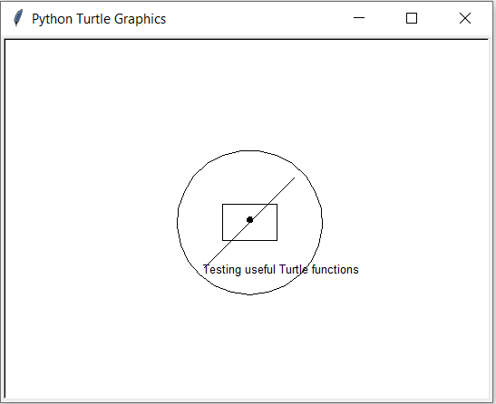
import turtle
from UsefulTurtleFunctions import *
# Draw a line from (-50, -50) to (50, 50)
drawLine(-50, -50, 50, 50)
# Write a text at (-50, -60)
writeText("Testing useful Turtle functions", -50, -60)
# Draw a point at (0, 0)
drawPoint(0, 0)
# Draw a circle at (0, 0) with radius 80
drawCircle(0, 0, 80)
# Draw a rectangle at (0, 0) with width 60 and height 40
drawRectangle(0, 0, 60, 40)
turtle.hideturtle()
turtle.done()
Use Custom Turtle Functions

Slide 45
Generalization
generalization - a technique that enables you to go from some specific examples to a solution that can be implemented as a program.

Slide 46
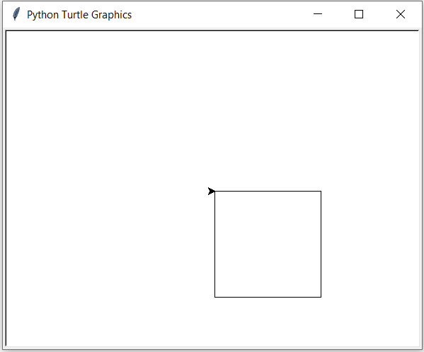
Drawing a Square
Write a function that can use any turtle to draw a square of any size.
We need two pieces of information to solve our problem.
These pieces of information will often become the parameters to our function.
The next step is to use the parameters along with the built-in methods of a turtle.
def drawSquare(myTurtle,sideLength):
for i in range(4):
myTurtle.forward(sideLength)
myTurtle.right(90)
import turtle
t = turtle.Turtle()
drawSquare(t,150)

Slide 47
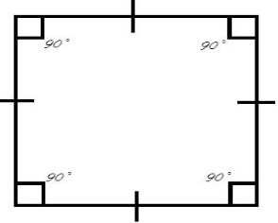
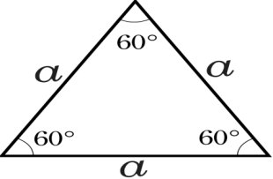
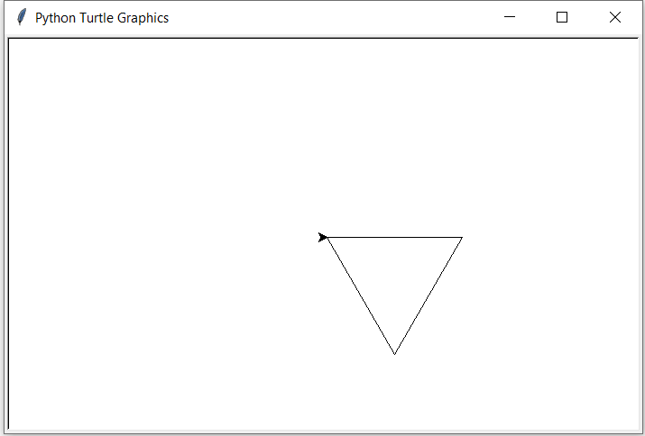
Drawing a Triangle
Change the call to range (4) to be range (3) since we only need three sides.
Change the number of degrees.
How many degrees do we need to turn each time to draw an equilateral triangle?
drawSquare function made four 90 degree turns 4 * 90 = 360
Draw a triangle needs 360 / 3 = 120.
def drawTriangle(myTurtle,sideLength):
for i in range(3):
myTurtle.forward(sideLength)
myTurtle.right(120)
import turtle
t = turtle.Turtle()
drawTriangle(t,150)

Slide 48
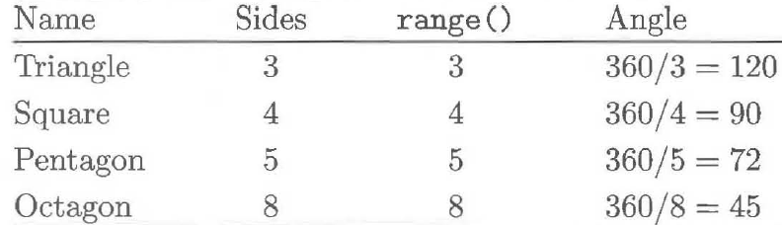
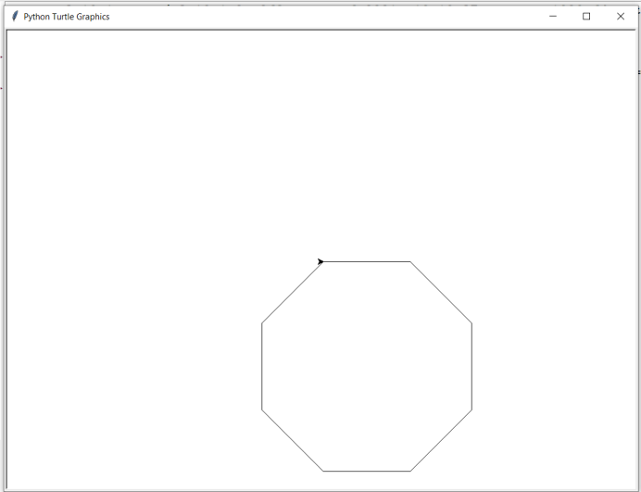
Drawing a Polygon
We can write a function that draws any regular polygon if we pass the function a third parameter.
The third parameter tells the function how many sides we want.
Once we know how many sides are required, we can easily have Python calculate the turning angle for us using the formula turnAngle = 360 / numSides.
def drawPolygon(myTurtle,sideLength,numSides):
turnAngle = 360 / numSides
for i in range(numSides):
myTurtle.forward(sideLength)
myTurtle.right(turnAngle)
import turtle
drawPolygon(turtle,150,8)

Slide 49
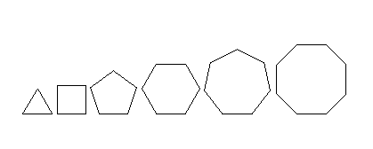
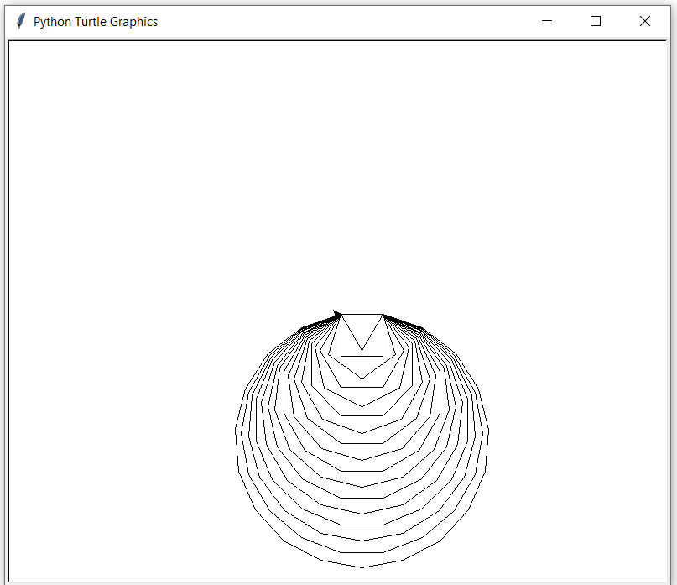
Drawing a Circle
As we increase the number of sides we get closer to circle shape.
Can we create a function that draws a circle with a specific radius?
def drawPolygon(myTurtle,sideLength,numSides):
turnAngle = 360 / numSides
for i in range(numSides):
myTurtle.forward(sideLength)
myTurtle.right(turnAngle)
import turtle
for i in range(3,20):
drawPolygon(turtle,50,i)

Slide 50
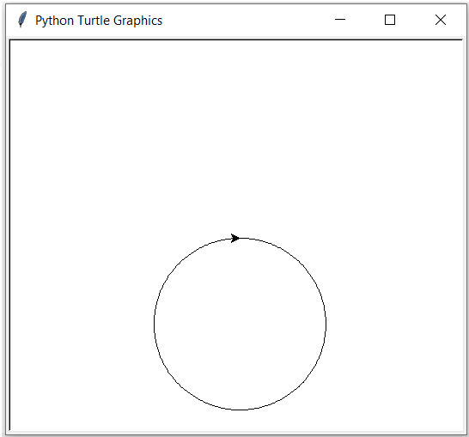
Drawing a Circle
def drawPolygon(myTurtle,sideLength,numSides):
turnAngle = 360 / numSides
for i in range(numSides):
myTurtle.forward(sideLength)
myTurtle.right(turnAngle)
def drawCircle(myTurtle,radius):
circumference = 2 * 3.1415 * radius
sideLength = circumference / 360
drawPolygon(myTurtle,sideLength,360)
import turtle
drawCircle(turtle,100)

